Slide 1



EFFECT OF AUTOMATIC DISINFECTION BOX USING ULTRA VIOLET LIGHT ON MICROBIAL GROWTH OF MICROORGANISMS
John Christopher B. Bagas
Charles Adriane S. Guerrero
Marcus M. Saralde
Engr. Jonathan C. Manarang
Engr. Pedrito M. Tenerife, Jr.
Design Project 2

Slide 2

BACKGROUND
Virus spread at rapid rate infecting many people.
Humans are constantly in contact with germs and bacteria (Kodoth et. Al., 2020).
Many surfaces and objects we come in contact with every day are covered in microorganisms that are potentially harmful to normal people with normal immunity.
Ultraviolet lights specifically UVC, have the trait to inactivate SARS-CoV-2 and shows effectivity against reducing germs and inhibits microbial growth (Francisco, 2022).
The 222-nm UVC lamps is relatively safe for human skin interaction and suggests disinfecting ability is comparable with the 254-nm UVC according to Nozomi et al. (2020).
4609
Polytechnic University of the Philippines

Slide 3
STATEMENT OF THE PROBLEM
What is the significant difference between ultraviolet-based disinfectant and alcohol-based disinfectant in terms of their effectiveness?
What is the significant effect of ultraviolet intensity to be use in terms of its effectiveness?
What is the significant difference among the different duration in terms of its effectiveness?
3.1 10 seconds
3.2 20 seconds
3.3 30 seconds
How does the automatic disinfection box be described in terms of?
4.1 Necessity
4.2 Quality
4.3 Price-quality ratio
4.4 Approval
4609
Polytechnic University of the Philippines

Slide 4
THEORETICAL FRAMEWORK
According Kitagawa et al. (2020), the efficiency 222-nm UVC irradiation technology on severe acute respiratory syndrome coronavirus 2 (SARS-CoV-2) in unoccupied and occupied spaces can be used.
According to Childress J. (2021), the 254-nm UV light and 222-nm UV are germicidal light wavelengths that inactivate bacteria and viruses.
According to Aisha et. Al (2018), Ultraviolet light destroys harmful microbes such as bacteria, yeast, molds, viruses and algae.
The 222-nm UVC lamps is relatively safe for human skin interaction according to Nozomi et al. (2020). The 222-nm UVC suggests disinfecting ability is comparable with the 254-nm UVC.
4609
Polytechnic University of the Philippines

Slide 5
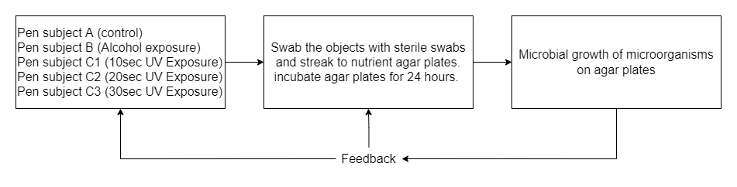
CONCEPTUAL FRAMEWORK
4609
Polytechnic University of the Philippines

Slide 6
SIGNIFICANCE OF THE STUDY
To the Users.
To the Users Groups/Workmates.
To the Environment.
To the Future Researchers.
4609
Polytechnic University of the Philippines

Slide 7
SCOPE AND LIMITATIONS
The study will be limited to the comparison of effectiveness of ultraviolet-based disinfection with alcohol-based (70% alcohol content, isopropyl) disinfection,
Determining if there’s a significant effect of ultraviolet intensity to be use in terms of its effectiveness, determining the significant difference among the duration of 10 seconds, 20 seconds, and 30 seconds in terms of its effectiveness, and determining the overall user rating of the device in terms of necessity, quality, price-quality ratio and approval.
The study will be limited to the effect of automatic disinfection box using ultra violet light on microbial growth of microorganisms, not determining the microorganism that grow on the nutrient agar, and not determining the UVC dosage and irradiance of the automatic disinfection box.
The study will not cover the comparisons of effectiveness of ultraviolet-based disinfection and specific brands of alcohol. The study will not cover the comparisons of the effectiveness of ultraviolet-based disinfection and different alcohol content (beside 70% alcohol content) of specific brands of alcohol.
4609
Polytechnic University of the Philippines

Slide 8
HYPOTHESIS
There is no significant difference between ultraviolet-based disinfectant and alcohol-based disinfectant in terms of their effectiveness.
There is no significant effect of ultraviolet intensity to be use in terms of its effectiveness.
There is no significant difference among the duration of 10 seconds, 20 seconds, and 30 seconds in terms of its effectiveness.
The automatic disinfection box does not meet current pandemic situation extremely well. The automatic disinfection box has a very low quality. The automatic disinfection box in terms of price has a poor value for money. The respondents are very dissatisfied using the automatic disinfection box.
4609
Polytechnic University of the Philippines

Slide 9
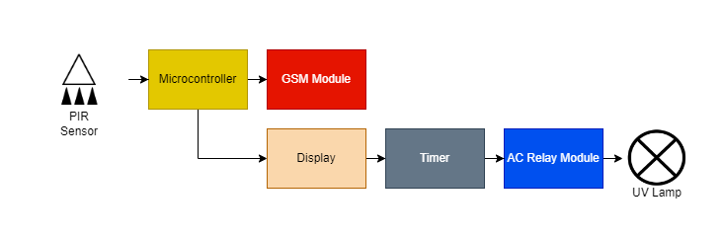
BLOCK DIAGRAM
Circuit Block Diagram
4609
Polytechnic University of the Philippines

Slide 10
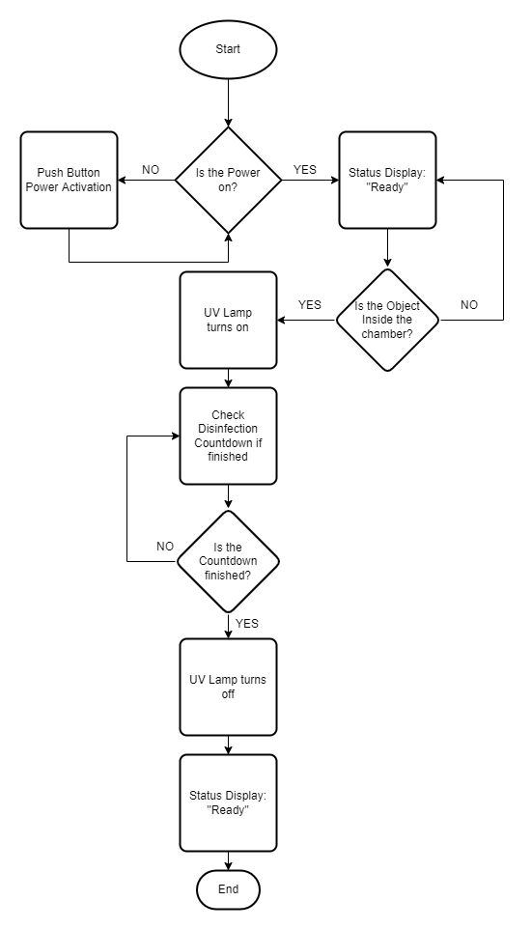
FLOWCHART
4609
Polytechnic University of the Philippines

Slide 11
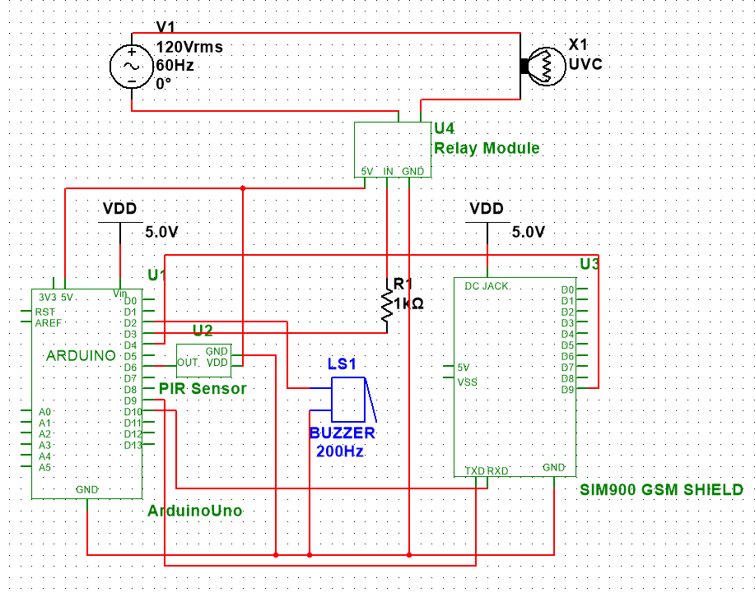
SCHEMATIC DIAGRAM
4609
Polytechnic University of the Philippines

Slide 12
METHODS OF RESEARCH
Quantitative experimental research design for statement of the problem 1 to 3.
Qualitative research design for statement of the problem 4a to 4d.
4609
Polytechnic University of the Philippines

Slide 13
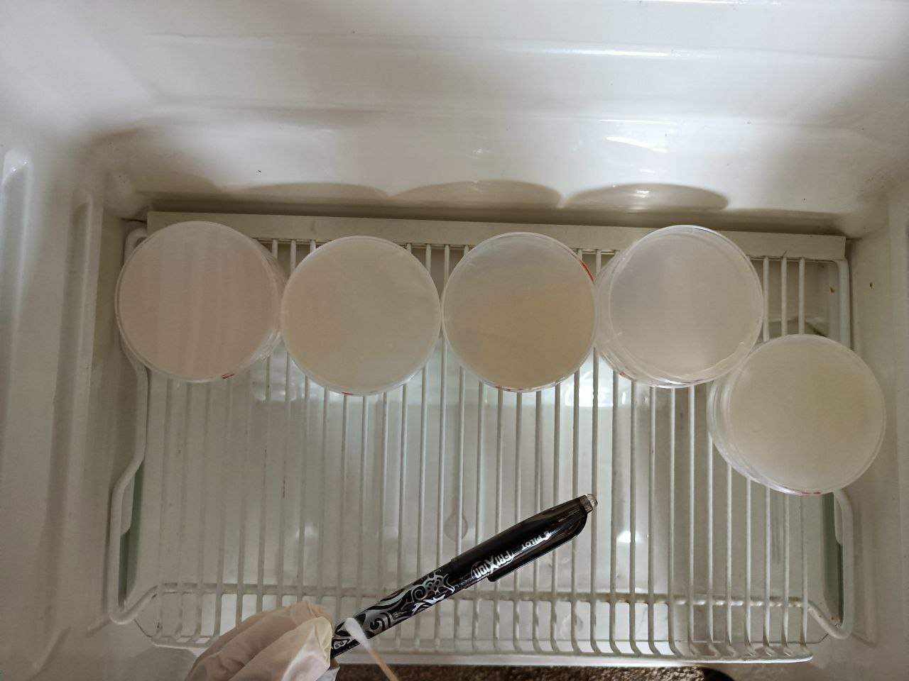
FIELD EXPERIMENT
Agar plate A
Pen 1
Streak plate Technique
4609
Polytechnic University of the Philippines

Slide 14
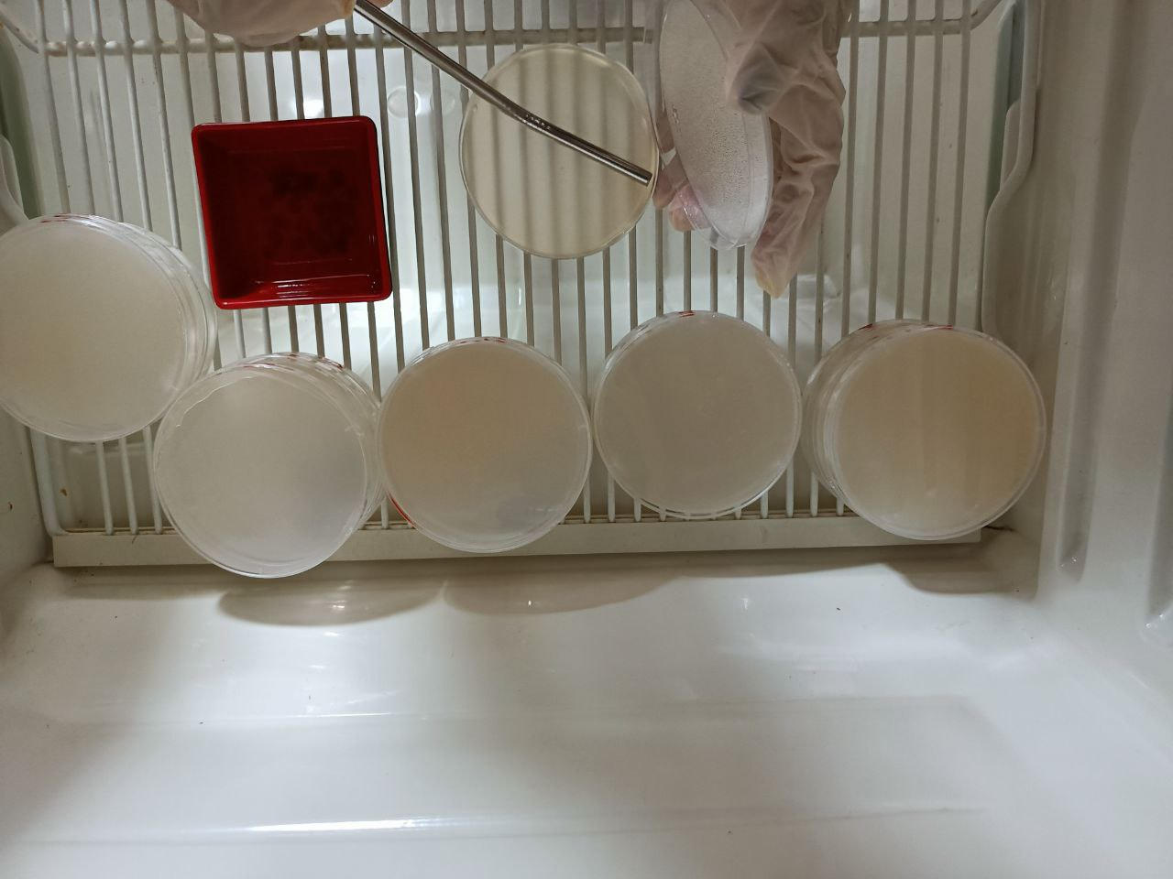
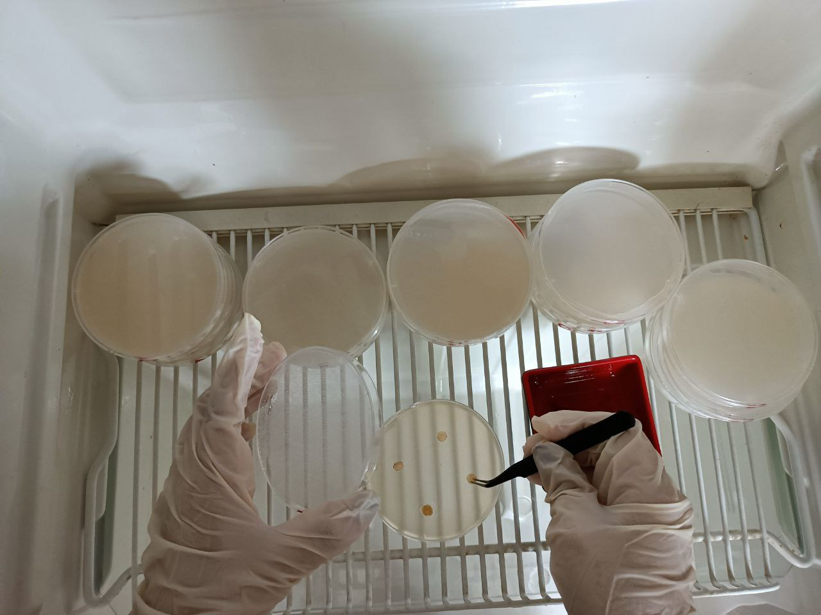
FIELD EXPERIMENT
Agar plate B
Pen 1
Spread plate technique
Disk Diffusion Test
4609
Polytechnic University of the Philippines

Slide 15
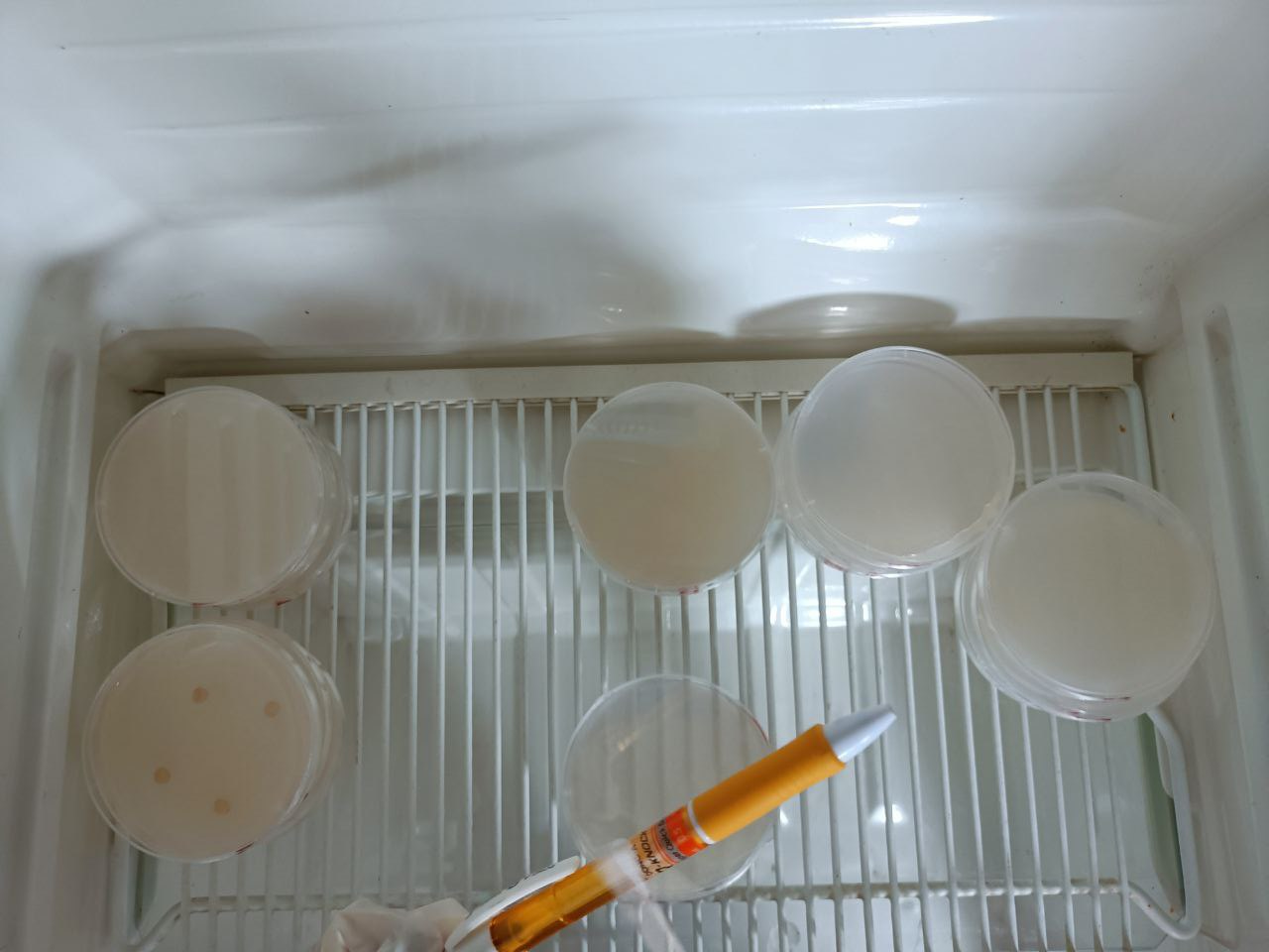
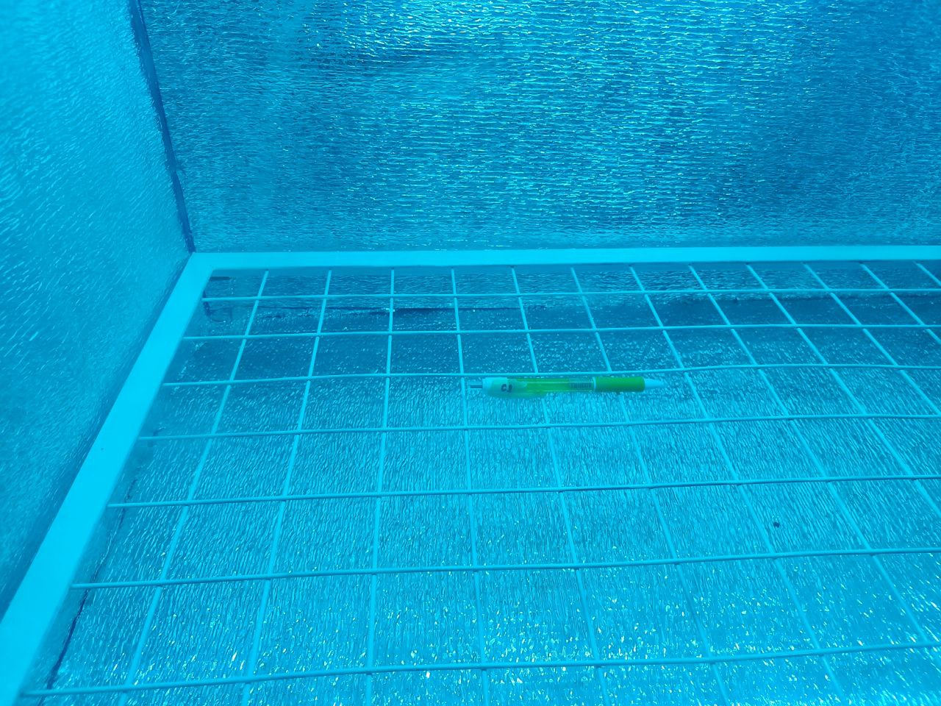
FIELD EXPERIMENT
Agar plate C1
Pen 2 disinfected for 10 seconds
Streak plate technique.
4609
Polytechnic University of the Philippines

Slide 16
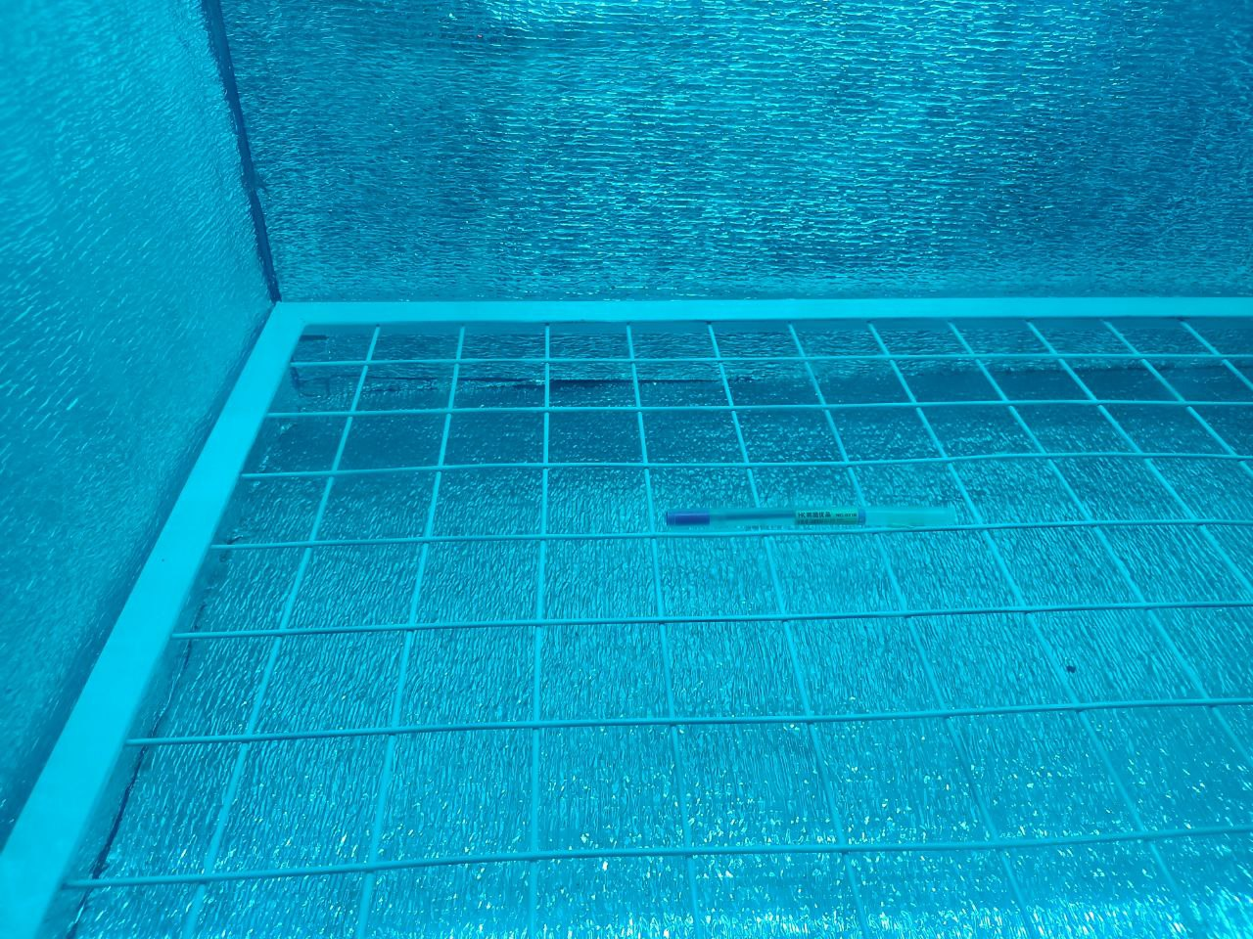
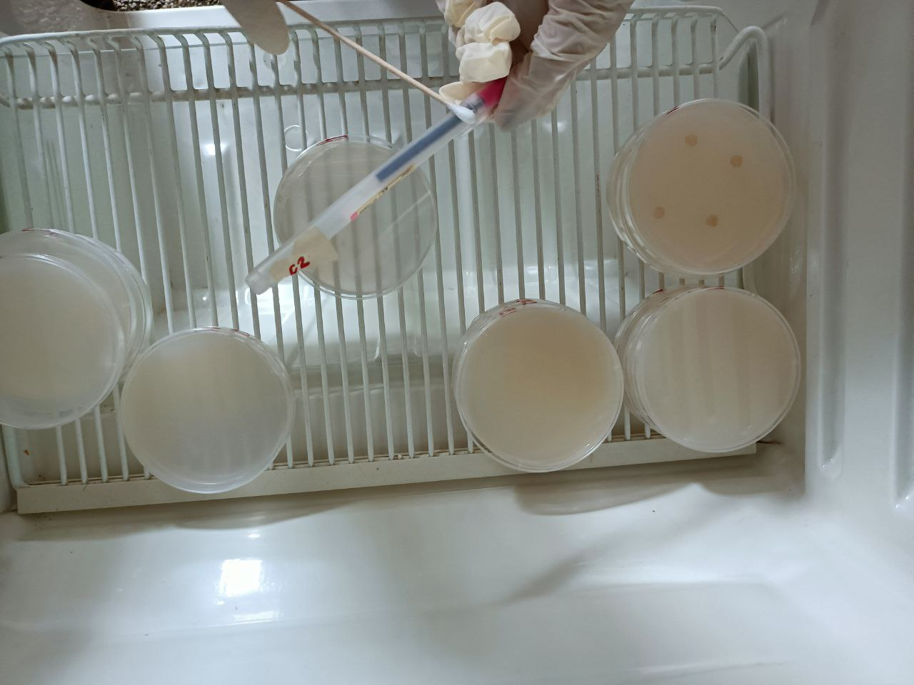
FIELD EXPERIMENT
Agar plate C2
Pen 3 disinfected for 20 seconds
Streak plate technique.
4609
Polytechnic University of the Philippines

Slide 17
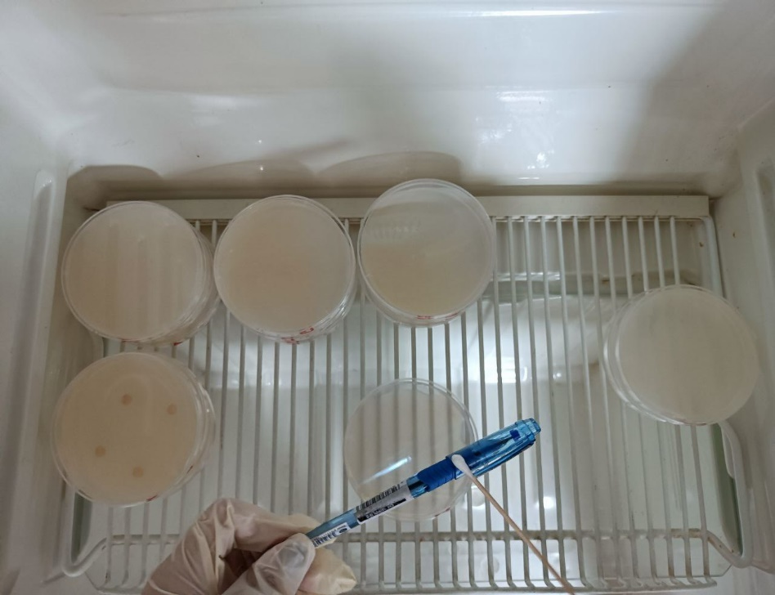
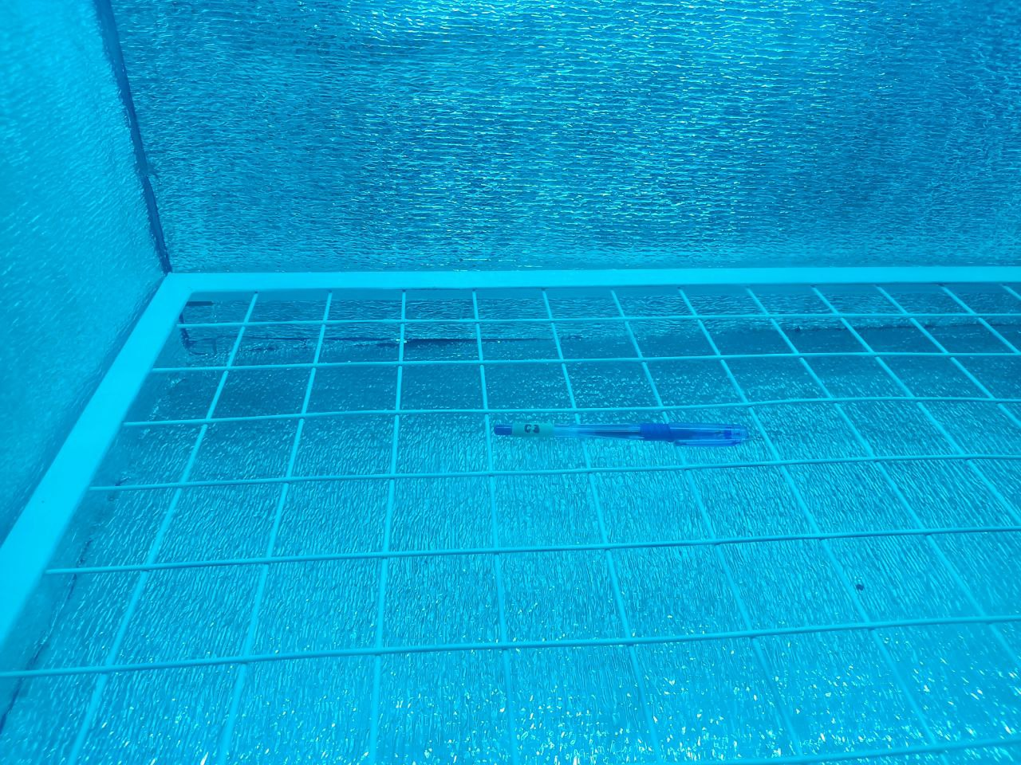
FIELD EXPERIMENT
Agar plate C3
Pen 4 disinfected for 30 seconds
Streak plate technique.
4609
Polytechnic University of the Philippines

Slide 18
DATA GATHERING PROCEDURE
Effectiveness of UV based and Alcohol based disinfectant were measured based on number of colonies in different treatments. Different treatments were replicated thrice and were compared to a baseline treatment wherein the agar plate was not exposed to UV or Alcohol.
The researchers use convenience sampling as a non-probability sampling method for statement of the problem 4a - 4d due to resource limitation in collecting feedback. The method yields a total 114 responses.
4609
Polytechnic University of the Philippines

Slide 19
STATISTICAL TREATMENT OF DATA
All statistical analyses were performed using R Studio v 4.2.1 and all test of significance were evaluated at 5% level.
Effectiveness of UV based and Alcohol based disinfectant were measured based on number of colonies in different treatments.
Different treatments were replicated thrice and were compared to a baseline treatment wherein the agar plate was not exposed to UV or Alcohol
4609
Polytechnic University of the Philippines

Slide 20
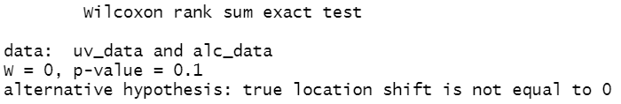
STATISTICAL TREATMENT OF DATA
Statement of the Problem 1
What is the significant difference between ultraviolet-based disinfectant and alcohol-based disinfectant in terms of their effectiveness?
Result of Two-Samples Wilcoxon Test
4609
Polytechnic University of the Philippines

Slide 21
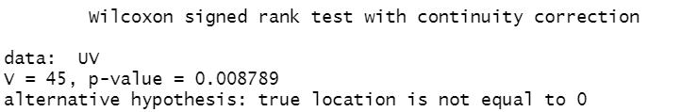
STATISTICAL TREATMENT OF DATA
Statement of the Problem 2
What is the significant effect of ultraviolet intensity to be use in terms of its effectiveness?
Result of One-Sample Wilcoxon Test
4609
Polytechnic University of the Philippines

Slide 22
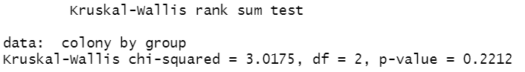
STATISTICAL TREATMENT OF DATA
Statement of the Problem 3
What is the significant difference among the duration of 10, 20, 30 seconds in terms of its effectiveness?
Result of Kruskal-Walis Test
4609
Polytechnic University of the Philippines

Slide 23
RESULTS AND DISCUSSION
Since the p-value of 0.1 is greater than 5% level of significance (0.05), there is enough evidence to conclude that UV and Alcohol based disinfectant exhibit no significant difference when it comes to their effectiveness.
Since the One-Sample Wilcoxon Test resulted a p-value of 0.0088, and is less than 5% level of significance (0.05), it was therefore concluded that UV intensity has a significant effect in terms of effectiveness. This result supports the comparison of findings of Baseline treatment and UV based treatments in terms of bacterial inhibition since number of colonies from UV based treatments were lower than those from the former.
Since the Kruskal-Walis test yields a p-value of 0.2212, and is greater than 5% level of significance (0.05), therefore, the different durations of UV exposure show no significant difference in terms of effectiveness.
4609
Polytechnic University of the Philippines

Slide 24
RESULTS AND DISCUSSION
Statement of the Problem 4a – 4d. Device Description Analysis
 |  | Verbal Descriptions
Values | Statistical Range (mean) | SOP 4a | SOP 4b | SOP 4c | SOP 4d
1 | 1 - 1.74 | Extremely Well | Very High Quality | Excellent | Very Satisfied
2 | 1.75 - 2.49 | Very Well | High Quality | Above Average | Somewhat Satisfied
3 | 2.5 - 3.24 | Not So Well | Low Quality | Below Average | Somewhat Dissatisfied
4 | 3.25 - 4 | Not at all Well | Very Low Quality | Poor | Very Dissatisfied
4609
Polytechnic University of the Philippines

Slide 25
RESULTS AND DISCUSSION
Statistical analysis of Four-point Likert Scale
 | Necessity (SOP4a) | Quality (SOP 4b) | Price-Quality Ratio (SOP 4c) | Approval (SOP 4d)
Mean | 1.36 | 1.43 | 2.15 | 1.49
 | Extremely Well | Very High Quality | Above Average | Very Satisfied
Overall Mean | 1.61
Respondents | 114
4609
Polytechnic University of the Philippines

Slide 26
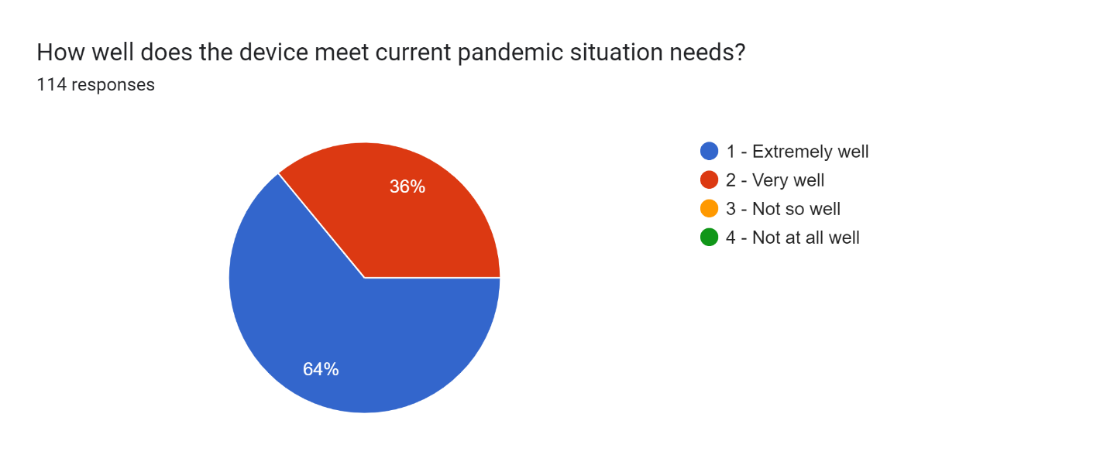
RESULTS AND DISCUSSION
4609
Polytechnic University of the Philippines

Slide 27
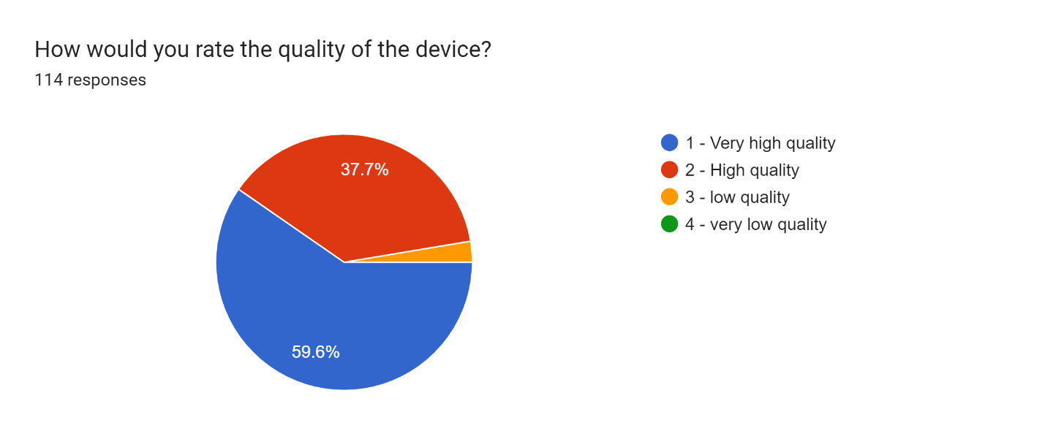
RESULTS AND DISCUSSION
4609
Polytechnic University of the Philippines

Slide 28
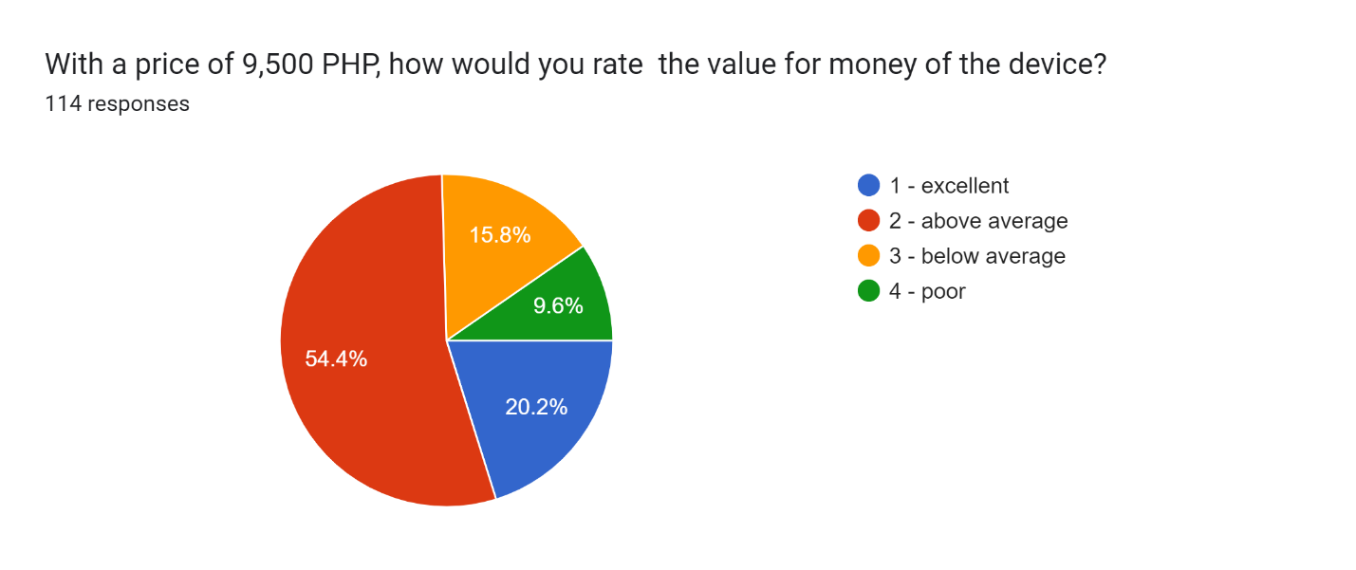
RESULTS AND DISCUSSION
4609
Polytechnic University of the Philippines

Slide 29
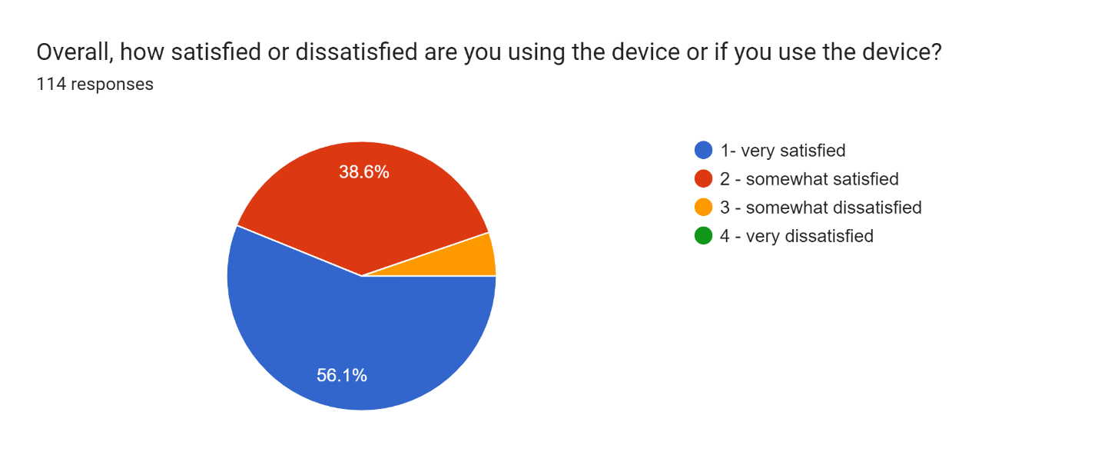
RESULTS AND DISCUSSION
4609
Polytechnic University of the Philippines

Slide 30
CONCLUSIONS
There is enough evidence to conclude that UV and Alcohol based disinfectant exhibit no significant difference when it comes to their effectiveness. UV intensity has a significant effect in terms of effectiveness and this result supports the comparison of findings of Baseline treatment and UV based treatments in terms of bacterial inhibition since number of colonies from UV based treatments were lower than those from the former, and the different durations of UV exposure of 10, 20, 30 seconds show no significant difference in terms of effectiveness.
Based on the statistical analysis, the automatic disinfection meets current pandemic situation extremely well, the automatic disinfection box has a very high quality in terms of quality, have an above average price-quality price ratio and the respondents are very satisfied using the automatic disinfection box.
4609
Polytechnic University of the Philippines

Slide 31
RECOMMENDATION
Develop a real-time UVC dosage monitor module that shows the current UVC dosage of the device producing.
Develop a BIOS of the system to save the current settings, device health, UVC lamp life.
Add feature that let the maintainer input their mobile phone number where the device is going to send the message. The length of the message can also be improved by adding more information to the message.
Add feature that when the registered number of the device received a “STATUS” the device will send the current status of the device.
Add a self-disinfect feature on the device handles to reduce transmission of virus and microorganisms.
Add buttons to the device like power switch to make it more intuitive.
4609
Polytechnic University of the Philippines

